Slide 1


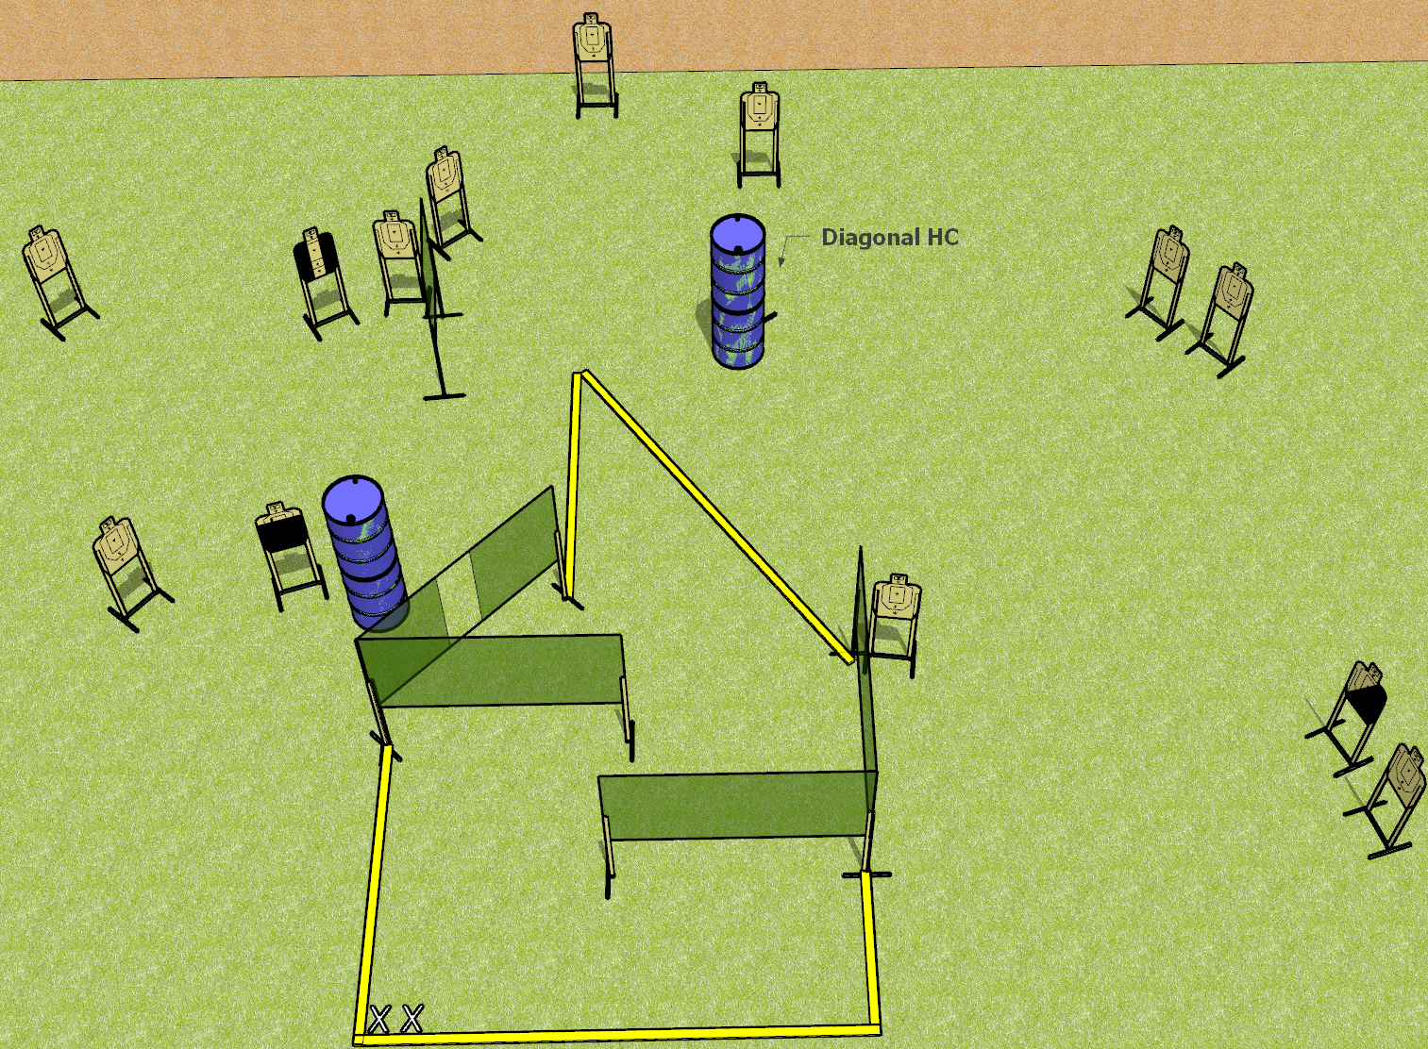
 | Dothan Gun Club – USPSA Match Step it Up Course Designer : Drew Coleman
28 rounds 14 paper
Equipment List 7 wall feet 1 medium fault line Hard cover: 1 left diagonal, 1 right diagonal, 1 tuxedo, 1 with tape 5 inches below the shoulder perf

Slide 2
Step it Up
Written Stage Briefing
Step it Up is a 28 round, 140 point, Comstock field course. There are 14 USPSA targets. The best 2 hits on paper will score. The start signal is audible.
Handgun start position is both feet on X’s, wrists below belt. Handgun has loaded magazine inserted, empty chamber, holstered.
PCC start position is both feet on X’s. Carbine is held with both hands, loaded magazine inserted with an empty chamber, safety on.
On start signal, engage targets as they become available from within the shooting area.

